Slide 1

Data Analytics : Heart Disease UCI Group Project ALY6015: Intermediate Analytics Adeyemi Adebimpe Srinivas Shanmuga G Utsav Desai Dr. Yvonne Leung February 15, 2022

Slide 2

Project Context and Scope
Purpose of Analysis
Conduct a study and investigate the prevalence of heart disease in individuals of different age groups as well as gender-wise.
Background
According to the World Health Organization (W.H.O), an unhealthy diet, physical inactivity, and the harmful use of alcohol increase the risk of heart disease. In Canada, 49,891 (19.8%) heart disease deaths were recorded in 2013
Methods: 2-way Anova, StepAIC, Chi-Square, GLM

Slide 3
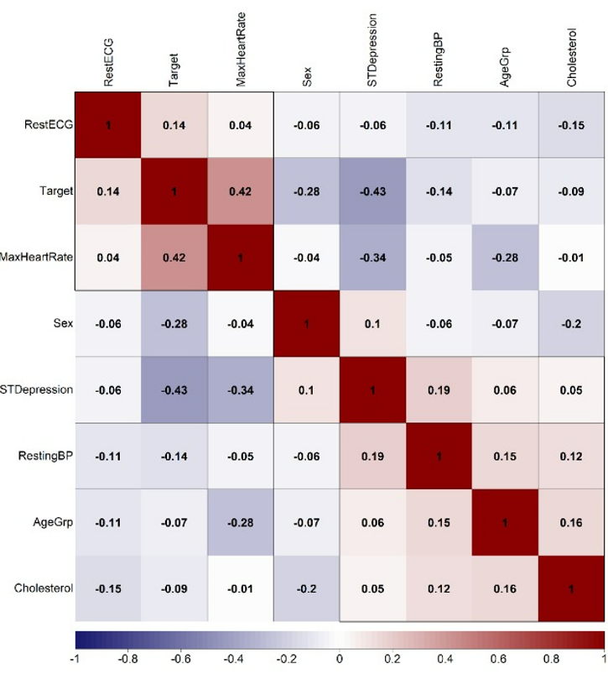
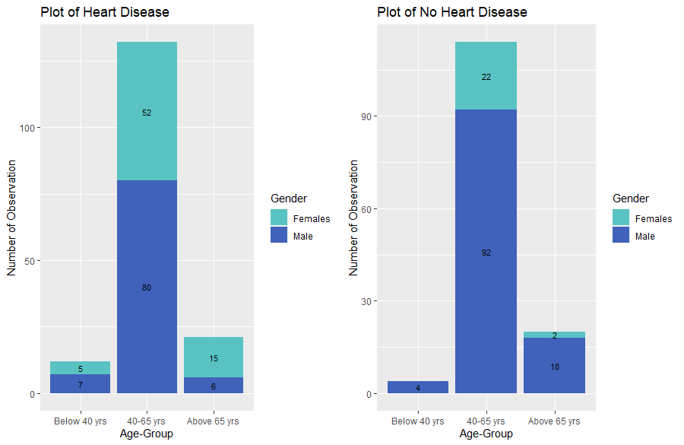
Preliminary Analysis
Age Group and Gender Classification
Descriptive and Inferential analysis
Correlation between the variables
T- test – Independent variables
Figure 2: Bar Plot: Age Group and Gender Classification
Figure 1: Correlation Plot: Heart Disease Factors

Slide 4
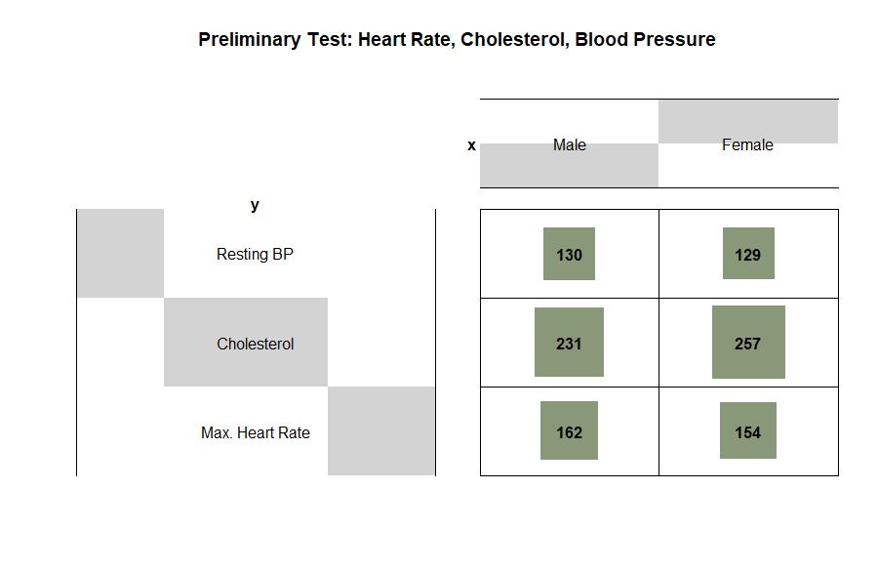
Chi- Square Analysis: Independence Test
Preliminary Tests – Max. Heart Rate, Cholesterol level & BP
Gender association with preliminary testing parameters
No association found between gender and testing parameters
X-squared | Degrees of Freedom | P-value | Critical Value
1.29415 | 2 | 0.5236 | 5.991
Table 1: Chi-Square results
Figure 3: Balloon visualization: Preliminary Tests

Slide 5
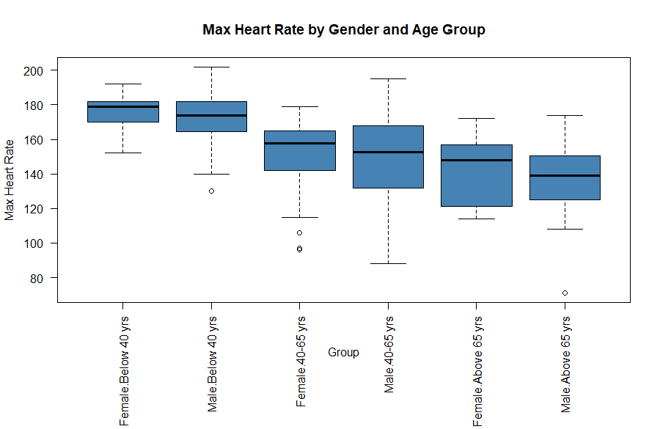
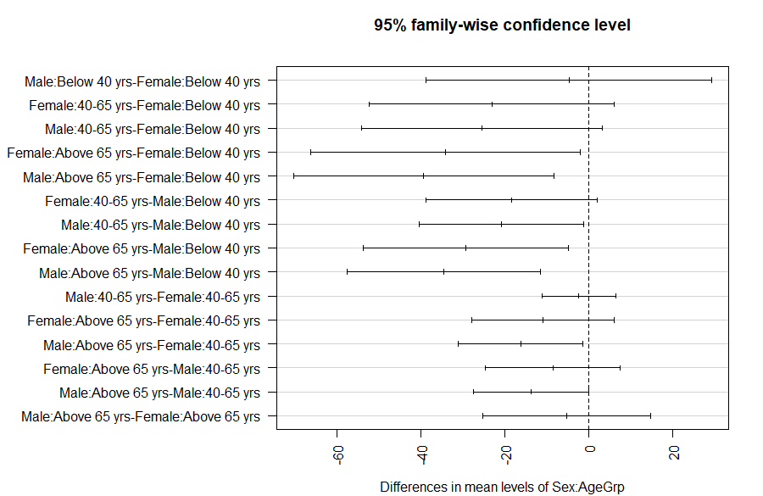
Two -way : Analysis of Variance Tests
Heart Rate, Age Group, and Gender Classification
Gender and Age impacts the maximum heart rate
Pairwise comparison: Tukey results
Figure 4: Box Plot: Max Heart Rate vs Gender (Age Group)
Figure 5: Tukey test result’s plot

Slide 6
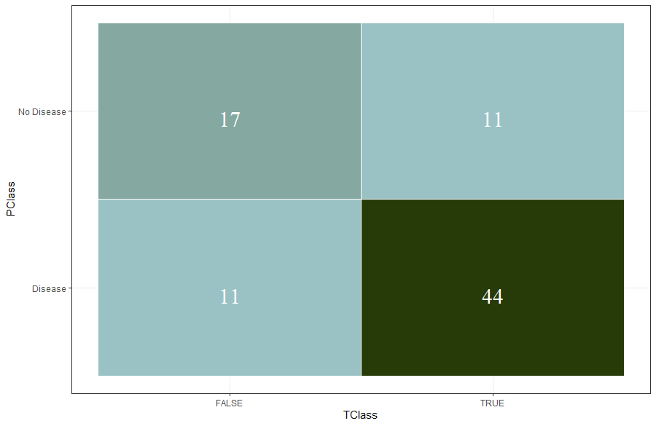
Predictive Modelling
GLM – Logistic Regression
Sex and Age interaction results in high collinearity
Model's accuracy is 73.49% and precision is 81.57%
Indicator​ | Training Data​ | Testing Data​
Accuracy​ | 82.72​ | 73.49​
Sensitivity​ | 84.54​ | 80.0​
Specificity​ | 80.90​ | 60.71​
Precision​ | 81.57​ | 81.57​
Table 2: Model's performance : Train and Test data
Figure 6: Confusion Matrix : Test data

Slide 7
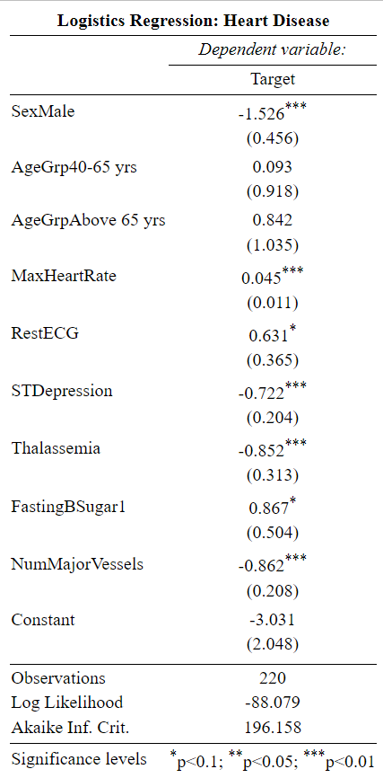
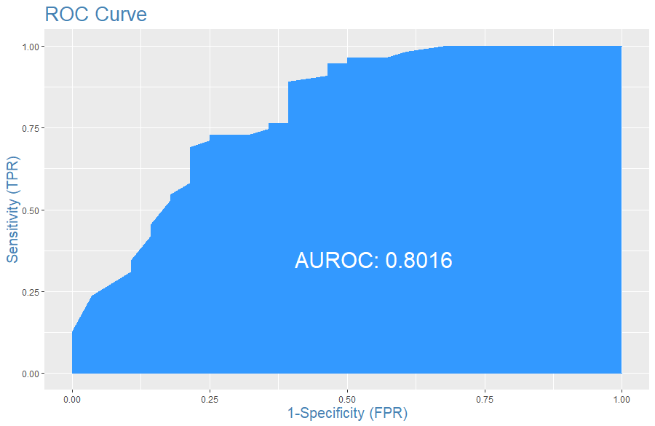
Predictive Modelling
Max. Heart Rate, Gender, and Cardiac Fluoroscopy has high significance in the model
The ROC curve indicates model's poor performance
F1 score is 0.80. Area under curve is 0.8016
Figure 7: The model's ROC plot
Table 3: Logistic Regression results

Slide 8

Summary
Methods such as StepAIC, Chi-Square, Two-way ANOVA, and Logistic regression were used.
Max Heart rate decreases with age
Cholesterol, Resting Blood pressure, and interaction of Sex and Age-group has no significance
Other risk factors can be rectified except for Thalassemia (hereditary disorder)
Recommendations – Lifestyle change and eating habits

Slide 9
Bibliography
Canada, P. H. A. of. (2017, February 10). Government of Canada. Canada.ca. Retrieved February 15, 2022, from https://www.canada.ca/en/public-health/services/publications/diseases-conditions/heart-disease-canada.html
Effective heart disease prediction using hybrid machine learning techniques. IEEE Xplore. (n.d.). Retrieved February 15, 2022, from https://ieeexplore.ieee.org/abstract/document/8740989
Google. (n.d.). T-Table.pdf. Google. Retrieved February 15, 2022, from https://docs.google.com/viewer?a=v&pid=sites&srcid=ZGVmYXVsdGRvbWFpbnxzdGF0aXN0aWNzYW5kb3J8Z3g6NzEyZGQ2NjdlYmIzYmRmMg
HDPS: Heart disease prediction system. IEEE Xplore. (n.d.). Retrieved February 15, 2022, from https://ieeexplore.ieee.org/abstract/document/6164626
R coder 💻 the best way to start learning R programming. R CODER. (2021, June 2). Retrieved February 15, 2022, from https://r-coder.com/
World Health Organization. (n.d.). Cardiovascular diseases (cvds). World Health Organization. Retrieved February 15, 2022, from https://www.who.int/news-room/fact-sheets/detail/cardiovascular-diseases-(cvds)#:~:text=The%20most%20important%20behavioural%20risk,lipids%2C%20and%20over

